Slide 1
AiBowl

Slide 2
What is AiBowl?
AiBowl is an innovative autonomous feeder for animals in a large area like a national park, that use a system composed by differents bowls and different collars, one for each animal.

Slide 3
The System
Our kit is easy to install and extensible, it is composed by:
One collar for each animal we want to track and feed. The collar is used to share the position of the animal. It has a GPS sensor which is used to perform this task, with a good degree of approximation.
One or more bowls, it depends on how many animals we want to manage. This, will have a more extensive sensor equipment: in fact it will be connected to a distance sensor, a camera and a servo motor.
A web application that can be used to track all the animals and have feedback on their routes, but also useful to keep an eye on the amount of food remaining in each bowl.

Slide 4
The Functioning
Our project foresees the presence of two digital twins: collars and bowl.
The bowl will have the task of detecting any animals in its vicinity using the distance sensor. This sensor will detect any presence at a distance of less than 50 cm from the bowl and, in the event that an animal is detected, it will initiate the recognition phase of the type of the animal itself.
This phase will be managed through the use of the supplied camera which will provide the prepared algorithm with all the photos necessary to perform the computation.
Once the type of animal is recognized, checks will be carried out which, based on the position of the bowl and the latest findings of the collars of the various animals, will allow us to understand which animal is actually near the bowl and if it can eat.
In the event that the verification gives a positive result through the use of the servo motor, an adequate amount of food will be released to the animal, the database will be updated and a message will be sent to the forest rangers, who will have the task of keeping the bowls full of food.

Slide 5
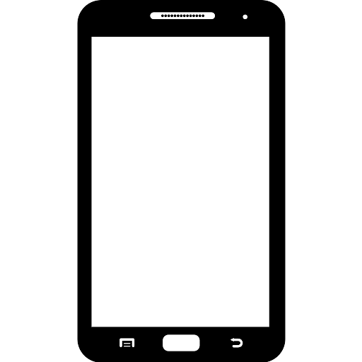




The Functioning
Cloud Server
Telegram
Web Application
Animal
AiBowl

Slide 6
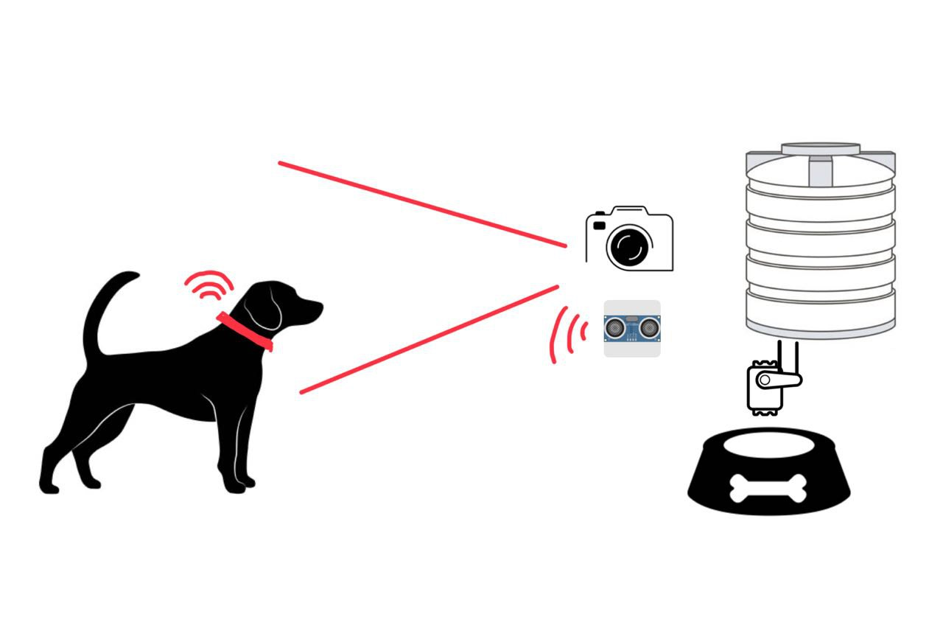
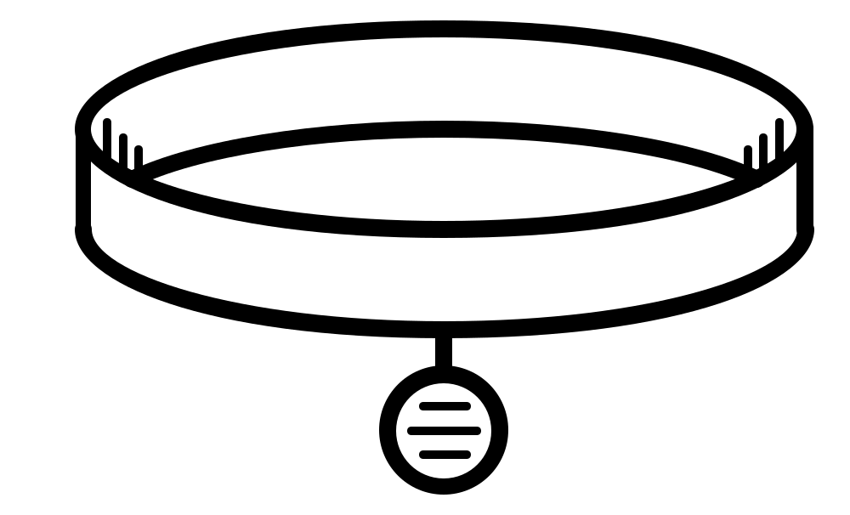
Bowl and Collar sensors

Slide 7
Web app
Homepage, where you can select different section of our web application.
Insert animal page, which provides the possibility to insert new animals after authentication by the forest ranger.
Animal map page, in this page it is possible to obtain a map showing all the last recorded positions for animals in possession of the collar with GPS sensor. This page can be used to obtain another map in which the various journeys made by the various animals.
Bowl management page, it is possible to obtain information on the current status of the tank capacity of the various bowls. In the event that a bowl runs out of food at its disposal by accessing this page, it is possible to identify it and, if there is a refill, to update the information on the capacity of the tank.
Recommended animals, page where you can insert a location by latitude and longitude and you can receive information about predictions about the animals that will be found in the bowl areas, based on the weather forecast.

Slide 8
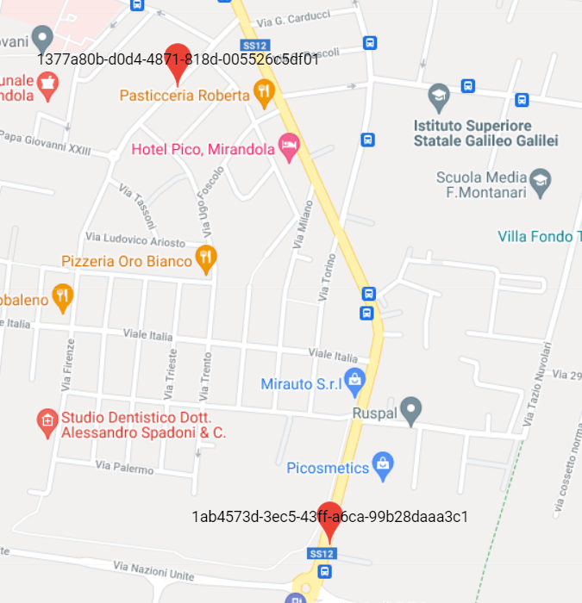
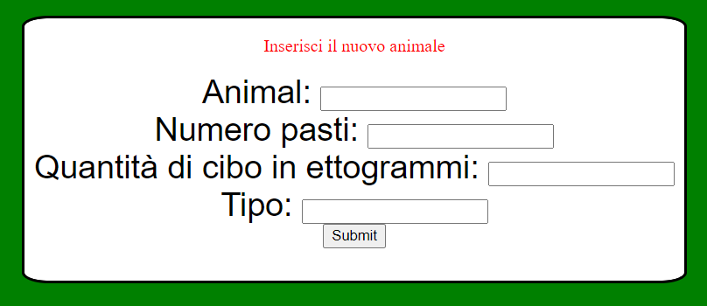
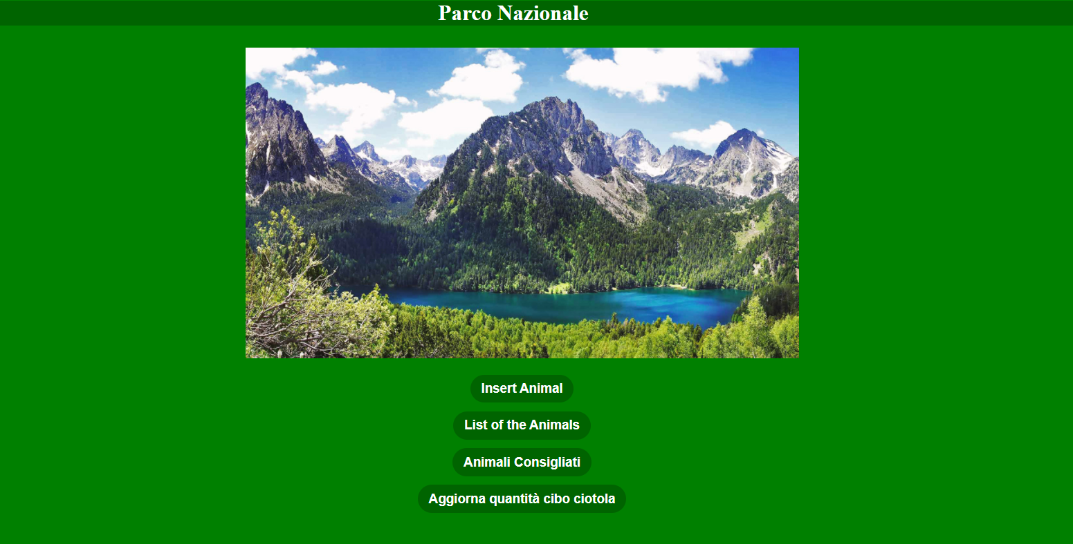
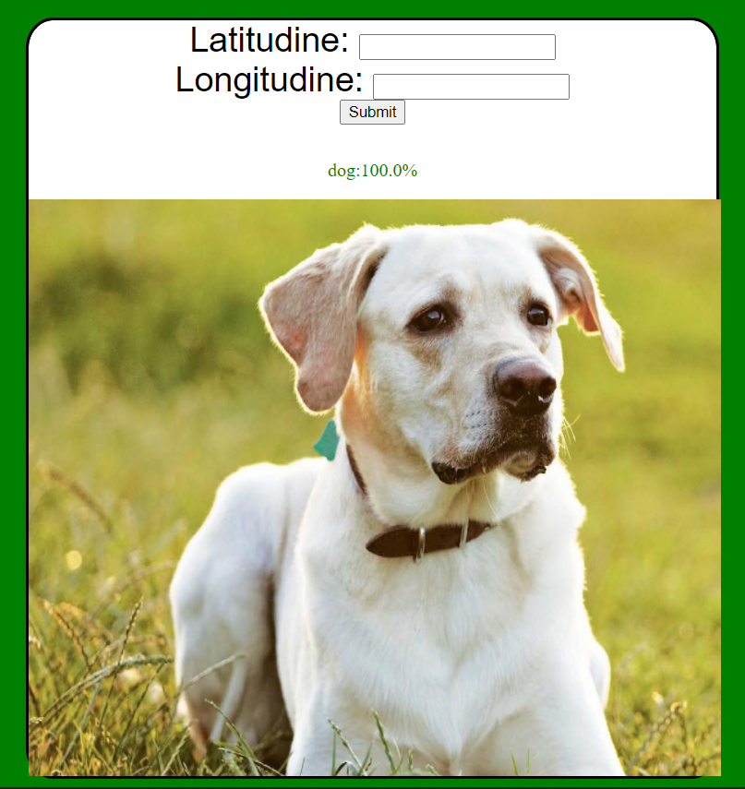
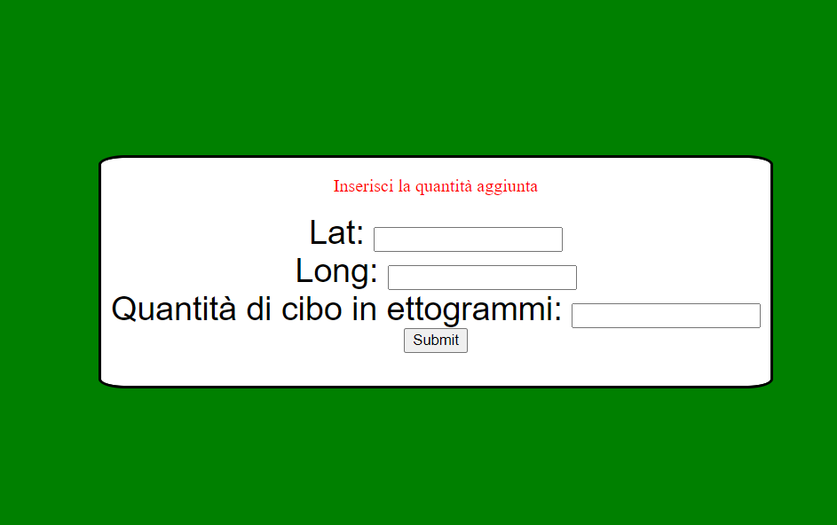
Web app Pages

Slide 9
Why use our system?
Easy management
Scalable
Autonomous system

Slide 10
HW & SW architecture
1. DIFFERENCES BETWEEN FINAL PRODUCT AND OUR PROTOTYPE
2. HARDWARE AND SOFTWARE USED FOR PROTOTYPE
3. FULL ARCHITECTURE WITH MAIN FUNCTIONALITIES

Slide 11
Differences from Idea to Prototype
We use our PC for testing and debugging the bridge script, obviously in a real simulation of the collar this is not possible because we want a not bulky and heavy collar, also it must include a battery.
Our bowl prototype provide only one actuator for food, however the bowl will provide different types of food (one actuator for each of them) depending on the animals.
Also the webcam is simulated with our PC webcam.

Slide 12
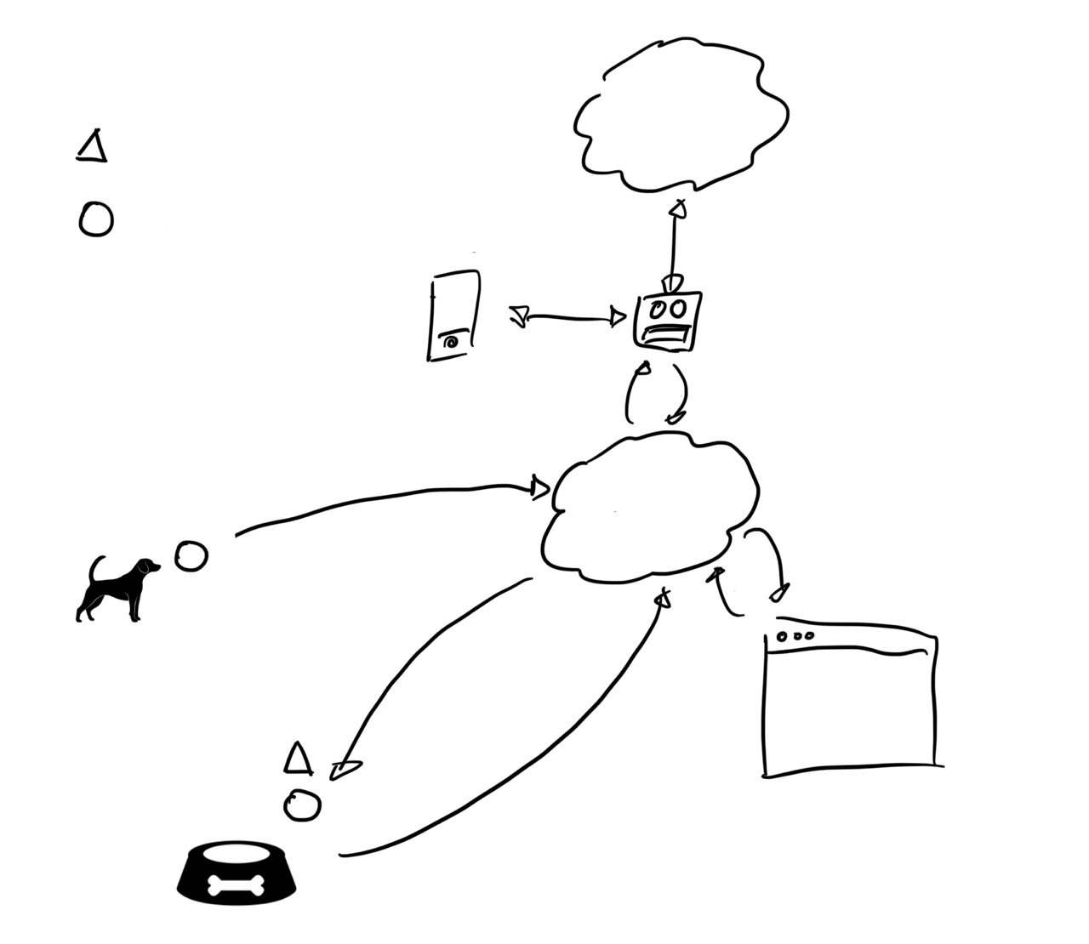
Simplified Architecture
Telegram
Server
Actuator
Arduino + sensors
Bot
Client
Server
Http
Bridge Animal
Web Application
Bridge Bowl

Slide 13
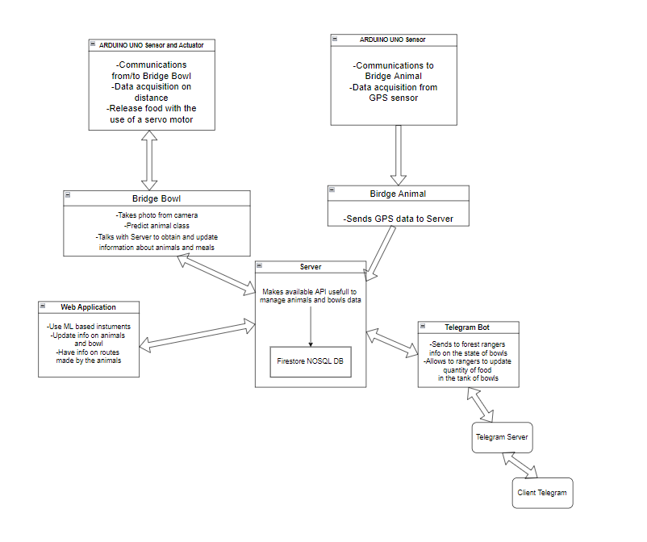
Detailed
Architecture

Slide 14








Hardware and Software used

Slide 15
Prototype
Hardware Used
Microcontroller: Arduino UNO x 2 (1 for bowl and 1 for animal)
Sensors: ultrasonic (HC-SR04), GPS (Neo6m) and webcam
Actuators: servo motor
Smartphone: client
Server Cloud: GCloud / localhost

Slide 16
Technical Talk

Slide 17
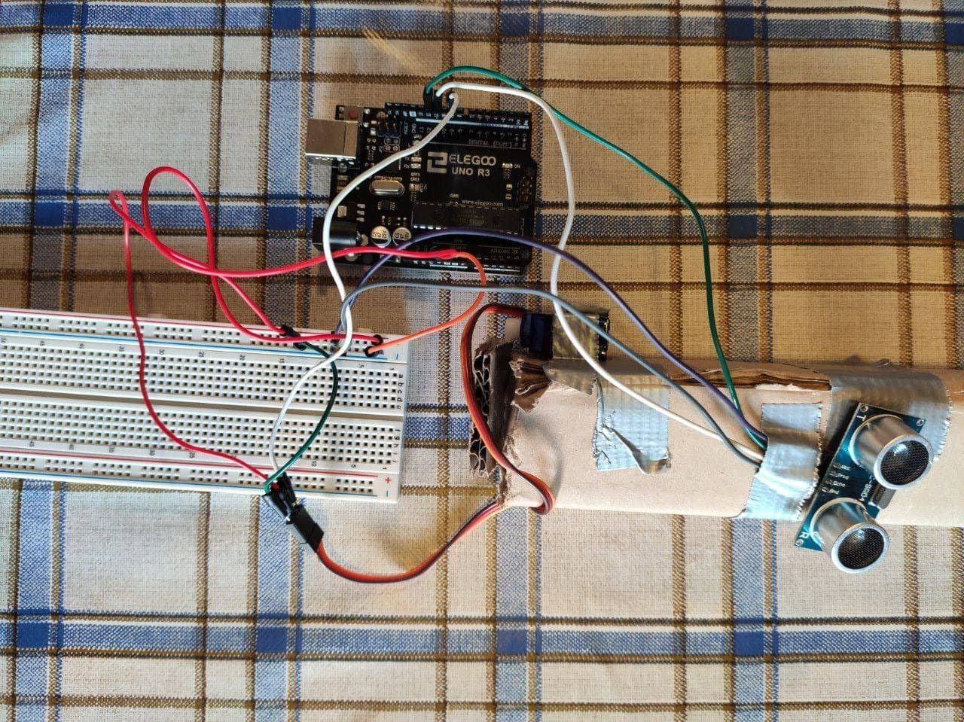
Bowl Prototype Circuit Schematic

Slide 18
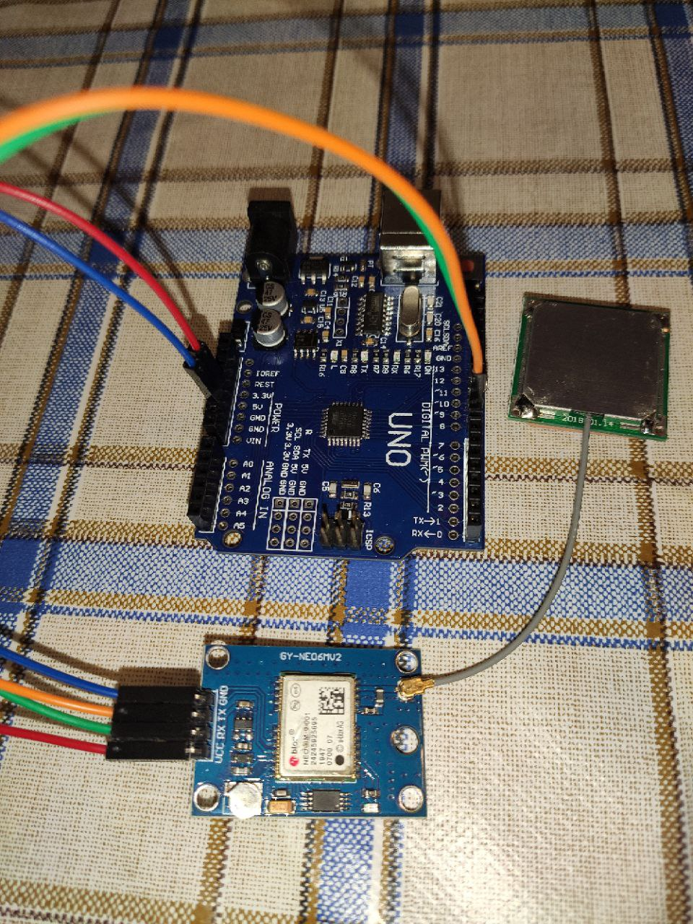
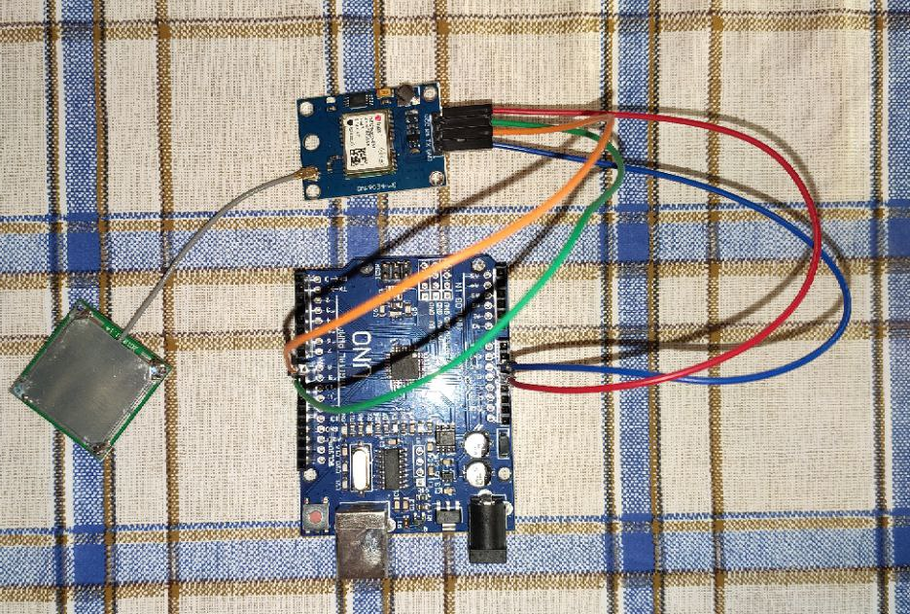
Collar Prototype Circuit Schematic

Slide 19
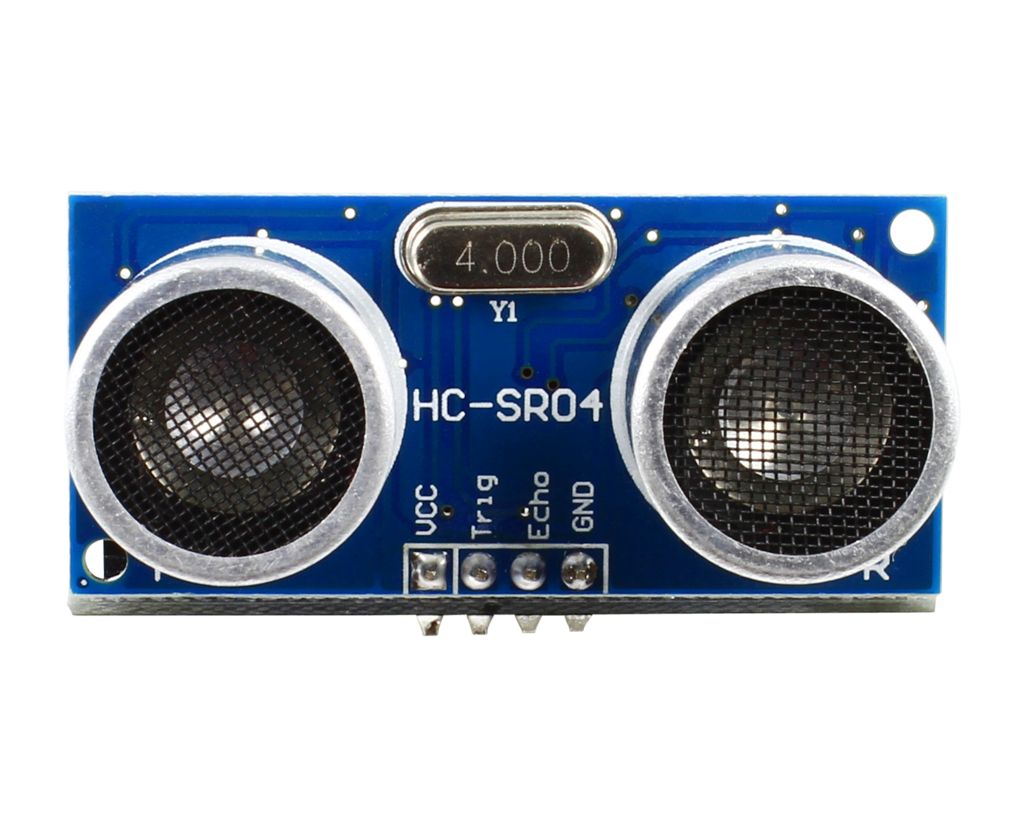
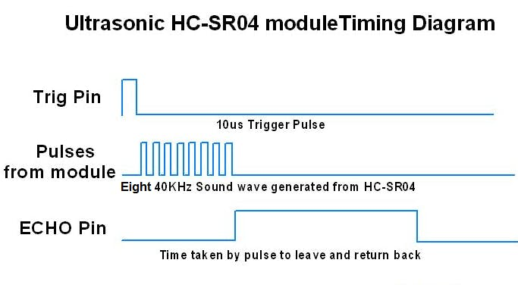
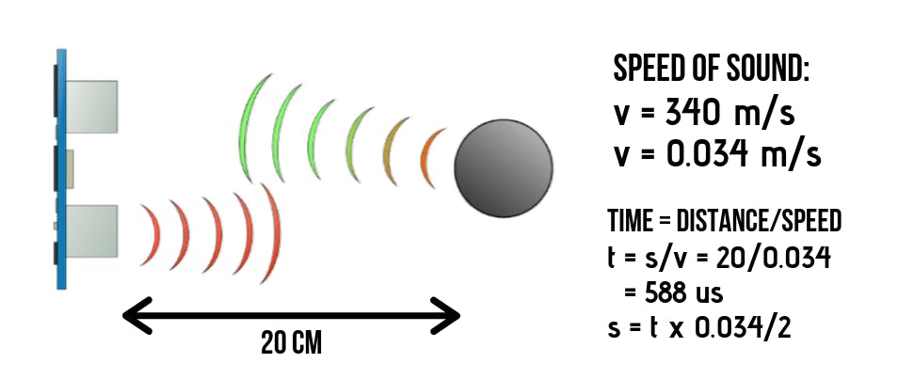
Sensor: Ultrasonic
Ultrasonic Sensor HC-SR04 is a sensor that can measure distance. It emits an ultrasound at 40kHz which travels through the air and if there is an object or obstacle on its path It will bounce back to the module. Considering the travel time and the speed of the sound you can calculate the distance.
The configuration pin of HC-SR04 is VCC (1), TRIG (2), ECHO (3), and GND (4). The supply voltage of VCC is +5V and you can attach TRIG and ECHO pin to any Digital I/O in your Arduino Board.

Slide 20
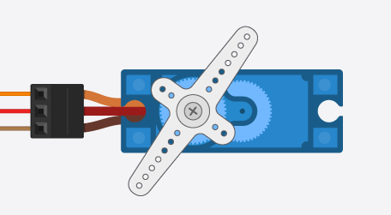
Actuator: Servo
Digital Pin
Power (5V)
Ground
Servos have integrated gears and a shaft that can be precisely controlled.
Standard servos allow the shaft to be positioned at various angles, usually between 0 and 180 degrees.
Continuous rotation servos allow the rotation of the shaft to be set to various speeds.
Library used: <Servo.h>

Slide 21
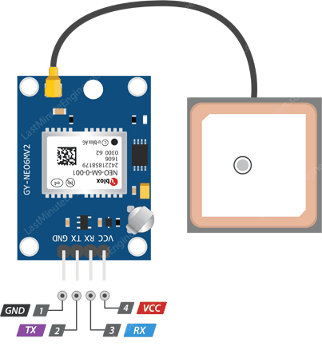
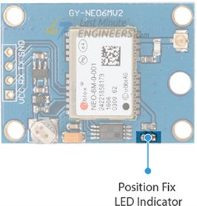
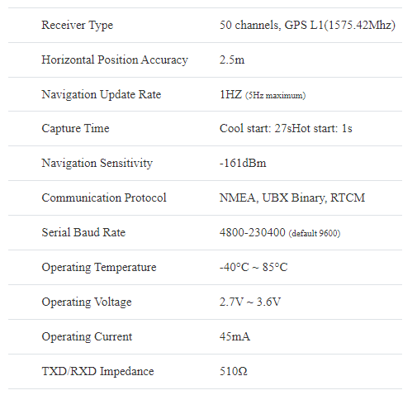
Sensor: GPS
It can track up to 22 satellites on 50 channels and achieves the industry’s highest level of sensitivity i.e. -161 dB tracking, while consuming only 45mA supply current.
Unlike other GPS modules, it can do up to 5 location updates a second with 2.5m Horizontal position accuracy. The u-blox 6 positioning engine also boasts a Time-To-First-Fix (TTFF) of under 1 second.
One of the best features the chip provides is Power Save Mode(PSM). It allows a reduction in system power consumption by selectively switching parts of the receiver ON and OFF. This dramatically reduces power consumption of the module to just 11mA making it suitable for power sensitive applications like GPS wristwatch.
The necessary data pins of NEO-6M GPS chip are broken out to a 0.1″ pitch headers. This includes pins required for communication with a microcontroller over UART. The module supports baud rate from 4800bps to 230400bps with default baud of 9600.
Library used: <TinyGPS++>
Details: https://lastminuteengineers.com/neo6m-gps-arduino-tutorial/

Slide 22
FSM

Slide 23
Sensors and Bridge FSM
Why use Finite State Machine patterns?
Robust software
Easy to change/add functionalities

Slide 24
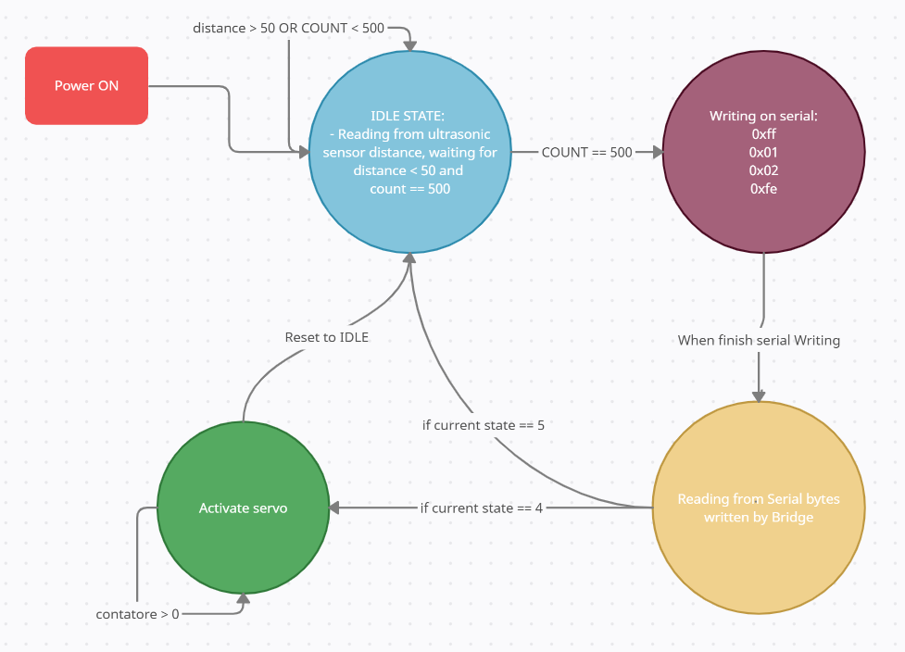
Finite State Machine for Bowl
Stato 1
Stato 2
Stato 4
Stato 3
Next Slide…

Slide 25
Finite State Machine for Bowl
S1
S2
if incoming byte == 0xff
if incoming byte == 0x02
S3
if incoming byte == 0x03
if last byte != 0xfe
if last byte == 0xfe
S5
S4

Slide 26
Bowl Protocol
0xFF | CID | Data | 0xFE | Description
* | 01 | 00 | * | notificare il bridge della ciotola riguardo la presenza di un animale
* | 02 | quantity | * | notifica al microcontrollore la quantitá di cibo da rilasciare all’animale
* | 03 | 00 | * | notifica al microcontrollore che l’animale non deve mangiare

Slide 27
Collar Protocol
0xFF | DIM | CID | Data | 0xFE
* | 19 | 01 | 9 per latitude 9 per longitude | * | notificare il bridge con la posizione dell’animale (successivamente da scomporre i byte ricevuti)

Slide 28
Web Application and Telegram Bot

Slide 29
Backend

Slide 30
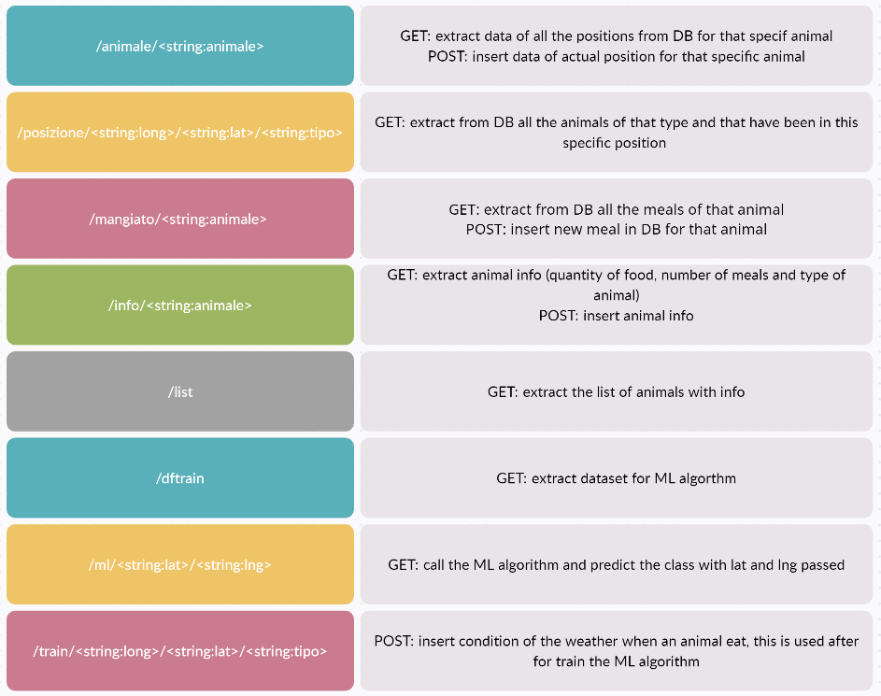
API Backend

Slide 31
Frontend

Slide 32
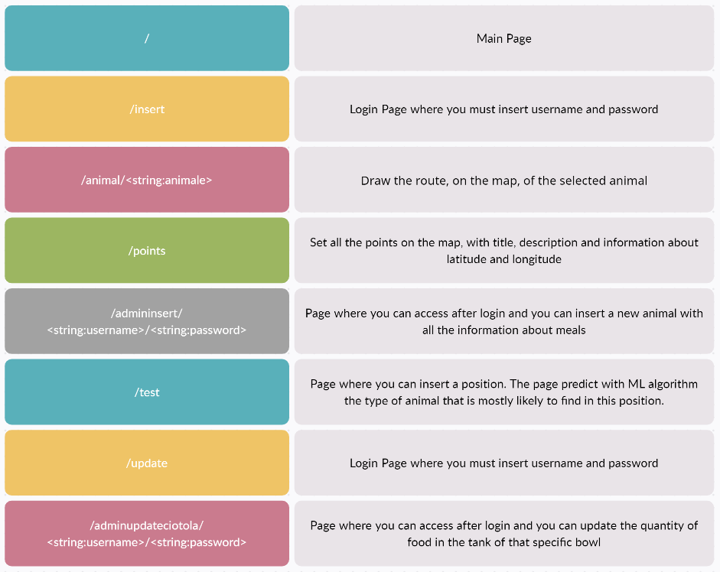
Frontend

Slide 33

API Telegram

Slide 34

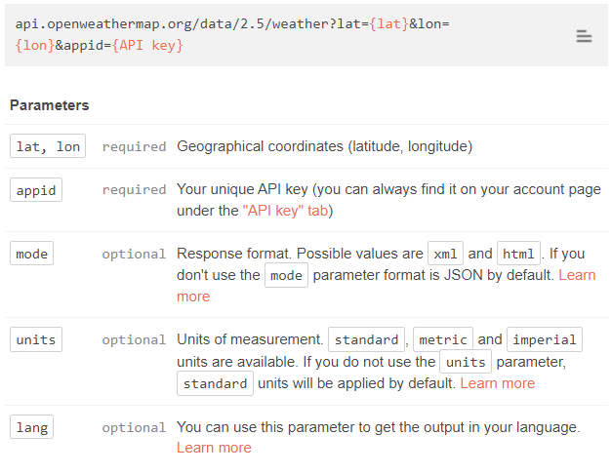
API Esterne

Slide 35
DataBase
Firestore

Slide 36
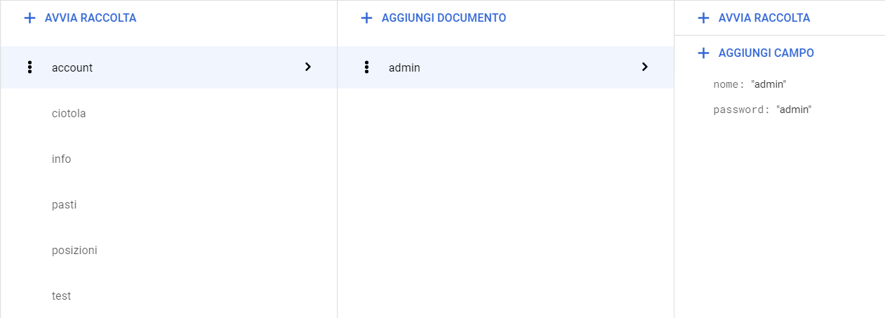
DataBase

Slide 37
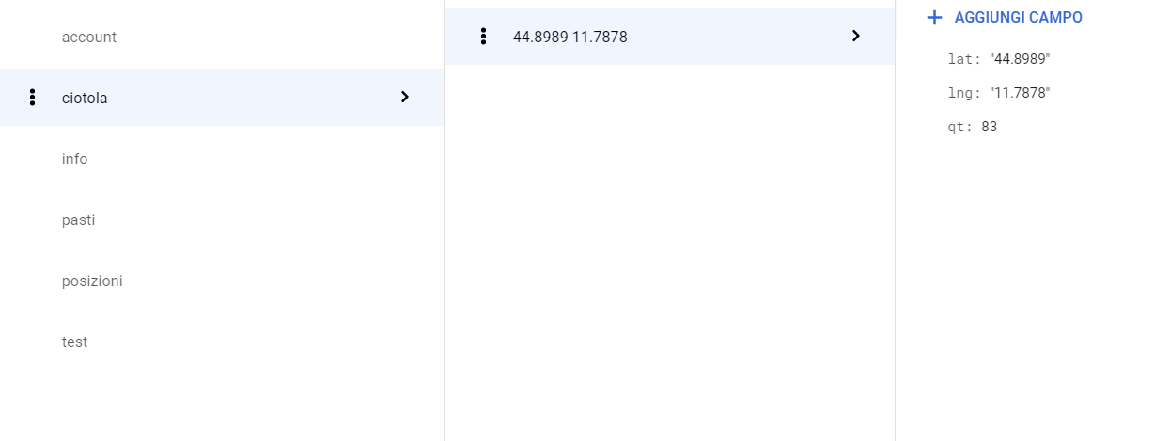
DataBase

Slide 38
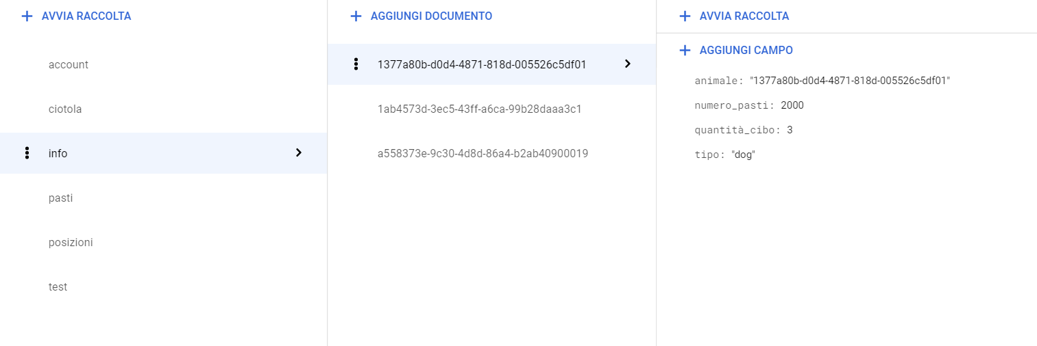
DataBase

Slide 39
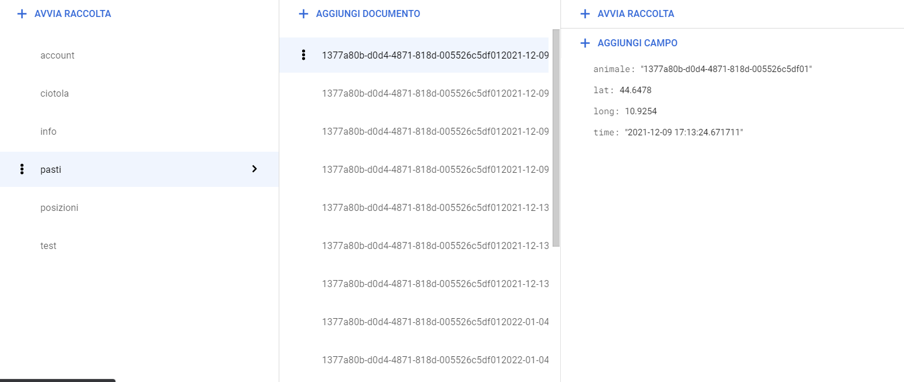
DataBase

Slide 40
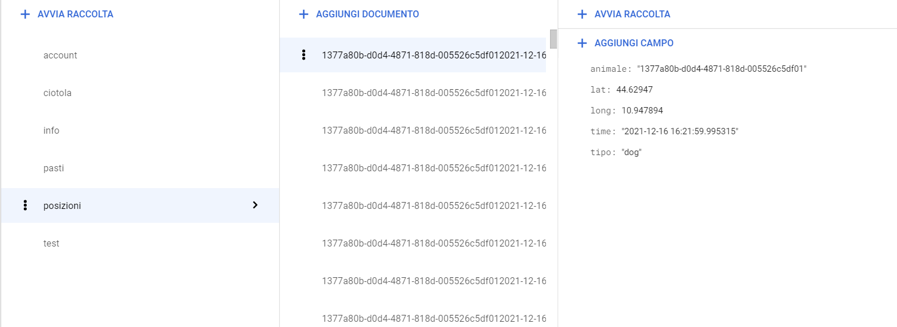
DataBase

Slide 41
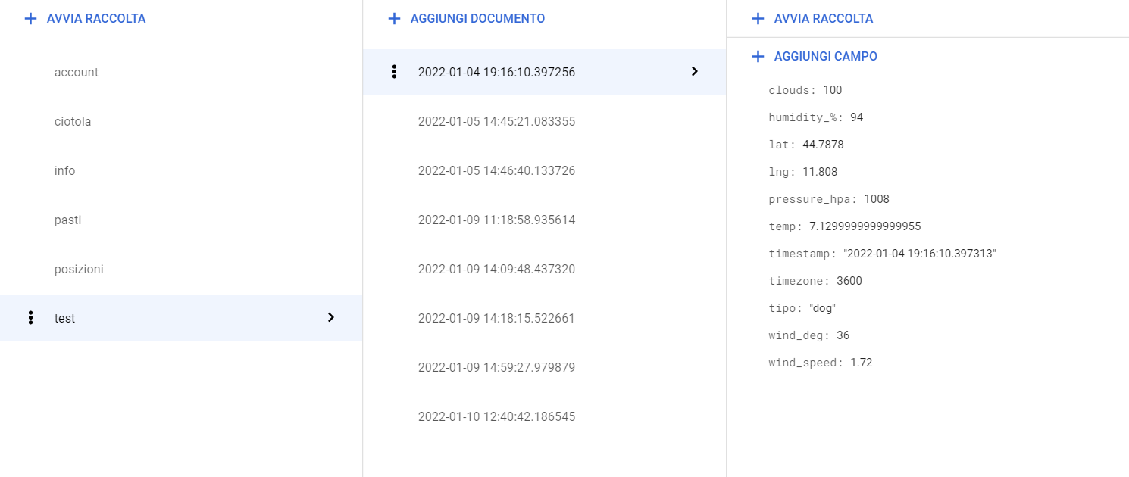
Database

Slide 42
AI
CNN and ML

Slide 43
Computer Vision Algorithm
We have train a CNN from scratch to predict what type of animal is in front of a bowl.
We have used a dataset from Kaggle with 1200+ images, divided equally.
Our algorithm is able to predict 7 different classes (dog, horse, chicken, cat, cow, sheep, and squirrel)

Slide 44
Machine Learning
The introduced ML algorithm is able to predict the type of animals that will mainly frequent the bowl in the indicated area.
The system is in continuous training as after each meal it will enter the meteorological conditions (calling OpenWeather API) and the type of animal that ate in the database.

Slide 45
Demo

Slide 46

Video Demo

Slide 47
Future improvements

Slide 48
Future Improvements
Add heart rate sensor in collar, to have more information about the animals.
Train the CNN to be able to add new types of animals.
Add different types of food for different animals.
Send photo of the animals when they eat on telegram (also useful for continuous training of the CNN)

Slide 49
Thanks for attention!

